Slide 1
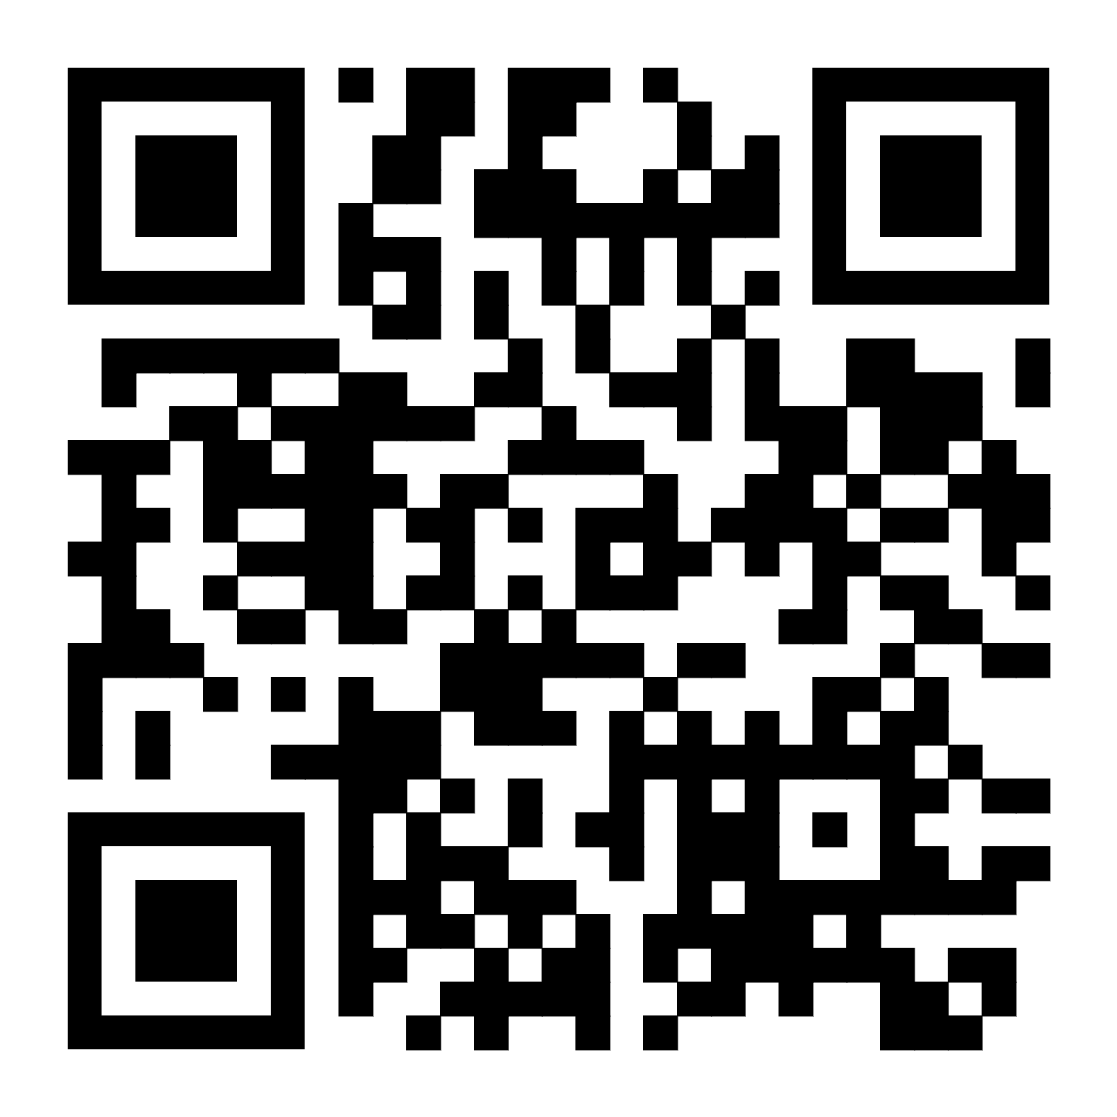

Exploring and Evaluating Interplays of BPpy with Deep Reinforcement Learning and Formal Methods
Tom Yaacov, Gera Weiss, Adiel Ashrov,
Guy Katz, Jules Zisser
20th International Conference on Evaluation of Novel Approaches to Software Engineering (ENASE) 2025
Notes:
Hello everyone, my name is Tom Yaacov, and today, I’ll present work that explores and evaluates the interplays of the behavioral programming paradigm with deep reinforcement learning and formal methods . This is a joint work with Gera Weiss, Adiel Ashrov, Guy Katz, and Yuli zisser. We are from Ben-Gurion university and the Hebrew University.

Slide 2

Motivation
Modern software engineering increasingly relies on formal methods and AI tools.
Existing frameworks involve various analysis tools and techniques each uses its own input language and modeling approach.
Manual integration is needed to combine analysis results with system code.
Research problem - finding a framework that can safely interweave user code and machine-generated artifacts while supporting formal analysis.
Notes:
As you probably know, modern software engineering practices increasingly rely on advanced analysis techniques and AI tools. However, while existing frameworks involve various analysis tools and techniques, each still uses its own input language and modeling approach, and this requires a manual integration that combines the analysis results with system code. Finding a framework that can safely interweave user code and machine-generated artifacts while supporting formal analysis is a challenging research problem.

Slide 3

Behavioral Programming (BP)
Requirements
Execution engine
Behavior
David Harel, Assaf Marron, and Gera Weiss, "Behavioral programming," Communications of the ACM, 2012.
Notes:
To glue this pieces together, in this project we propose the behavioral programming paradigm, or BP for short. BP is designed to allow its users the ability to describe the behavior of systems in a natural and intuitive way, in a way that is aligned with how humans perceive system requirements. Specifically, in BP each requirement is translated into a single module that can describe what the system can do, should do, or should not do. Given these modules, an execution engine interprets and interweaves them at runtime in a way that produces cohesive system behavior.

Slide 4


Behavioral Programming (BP)
R1: “Pour some small amount of hot water three times.”
Hot
Water
Cold
Water
@b_thread
def add_hot():
for i in range(3):
yield {request: Hot}
Yaacov, Tom. "BPpy: Behavioral Programming in Python." SoftwareX 24 (Dec. 2023), 101556.
Notes:
To better understand BP and our contribution, we’ll start with a short example, which is BP's Hello World. We have a system that controls two water taps, one for hot water and one for cold water. And we have requirements that describe how this system should operate. The first requirement states that the system should pour three portions of hot water. So we can translate this requirement into a BP module, which we call b-thread. Specifically, this b-thread is implemented in BPpy, a BP environment that is implemented in Python. So this b-thread requests the event of pouring hot water three times.

Slide 5
Behavioral Programming (BP)
R2: “Pour some small amount of cold water three times.”
Hot
Water
Cold
Water
@b_thread
def add_hot():
for i in range(3):
yield {request: Hot}
@b_thread
def add_cold():
for i in range(3):
yield {request: Cold}
Possible system traces:
Cold Hot
Hot
Cold
Hot
Cold
Hot
Cold
Hot
Cold
Hot
Cold
Hot
Hot
Hot
Cold
Cold
Cold
Yaacov, Tom. "BPpy: Behavioral Programming in Python." SoftwareX 24 (Dec. 2023), 101556.
Notes:
In the second requirement, we state that the system should pour three portions of cold water. Thus, we will implement another b-thread that is very similar to the first b-thread, only now instead of asking for the hot event we ask for the cold event. So how will runs, that means a sequence of generated events, of a program containing these two b-threads, would look like? Basically, since we request each event 3 times with no other limitations, the system will allow every run which includes three hot and three cold.

Slide 6
Behavioral Programming (BP)
R3: “Cold water should be poured between any two pouring of hot water.”
Hot
Water
Cold
Water
@b_thread
def add_hot():
for i in range(3):
yield {request: Hot}
@b_thread
def add_cold():
for i in range(3):
yield {request: Cold}
@b_thread
def control():
while True:
yield {waitFor: Hot}
yield {waitFor: Cold, block: Hot}
Notes:
Ok, now, let’s make things a bit more complicated and assume a third requirement is added which states that for safety concerns there should be a portion of cold water between any two hot portions. So to implement this requirement we will add a third b-thread that waits for hot to happen and then blocks it from happening again until cold happens. So what are the possible possible executions now?
In order to answer this, we need to get deeper into BP’s execution mechanism. At any given moment, each b-thread states what it requests that will happen, what it waits for (but not requests), and what it blocks from happening. After submitting the statement, the b-thread pauses and waits for new instructions. The execution mechanism collects all statements and selects a single event that is requested and not blocked. If there are more than one, it picks randomly. After selecting the event, the mechanism advances all b-threads that either requested or waited for that event, leaving others paused, and their statements are carried forward to the next round. This process is continued through the run of the program.

Slide 7
Behavioral Programming (BP)
Hot
Water
Cold
Water
@b_thread
def add_hot():
for i in range(3):
yield {request: Hot}
@b_thread
def add_cold():
for i in range(3):
yield {request: Cold}
Hot
Cold
Cold
Hot
Cold
Hot
?
?
Cold Hot
Cold Hot
Cold Hot
Hot
Cold
Cold
Cold Hot
@b_thread
def control():
While True:
yield {waitFor: Hot}
yield {waitFor: Cold, block: Hot}
Cold
Cold Hot
Cold Hot
Notes:
So basically, since the third b-thread repeatedly waits for Hot and then blocks it while waiting for Cold, the program now will only include runs that do not have two consecutive hot events. So we will get some of the runs we saw in the previous version, which include exactly three hot and exactly three cold, but we will also get some runs that include less than 3 hot. They are possible since as soon as the system finishes doing 3 cold and it has more than two hot events left to execute, we can't do both because the second one will be blocked by the second statement in the third b-thread.

Slide 8
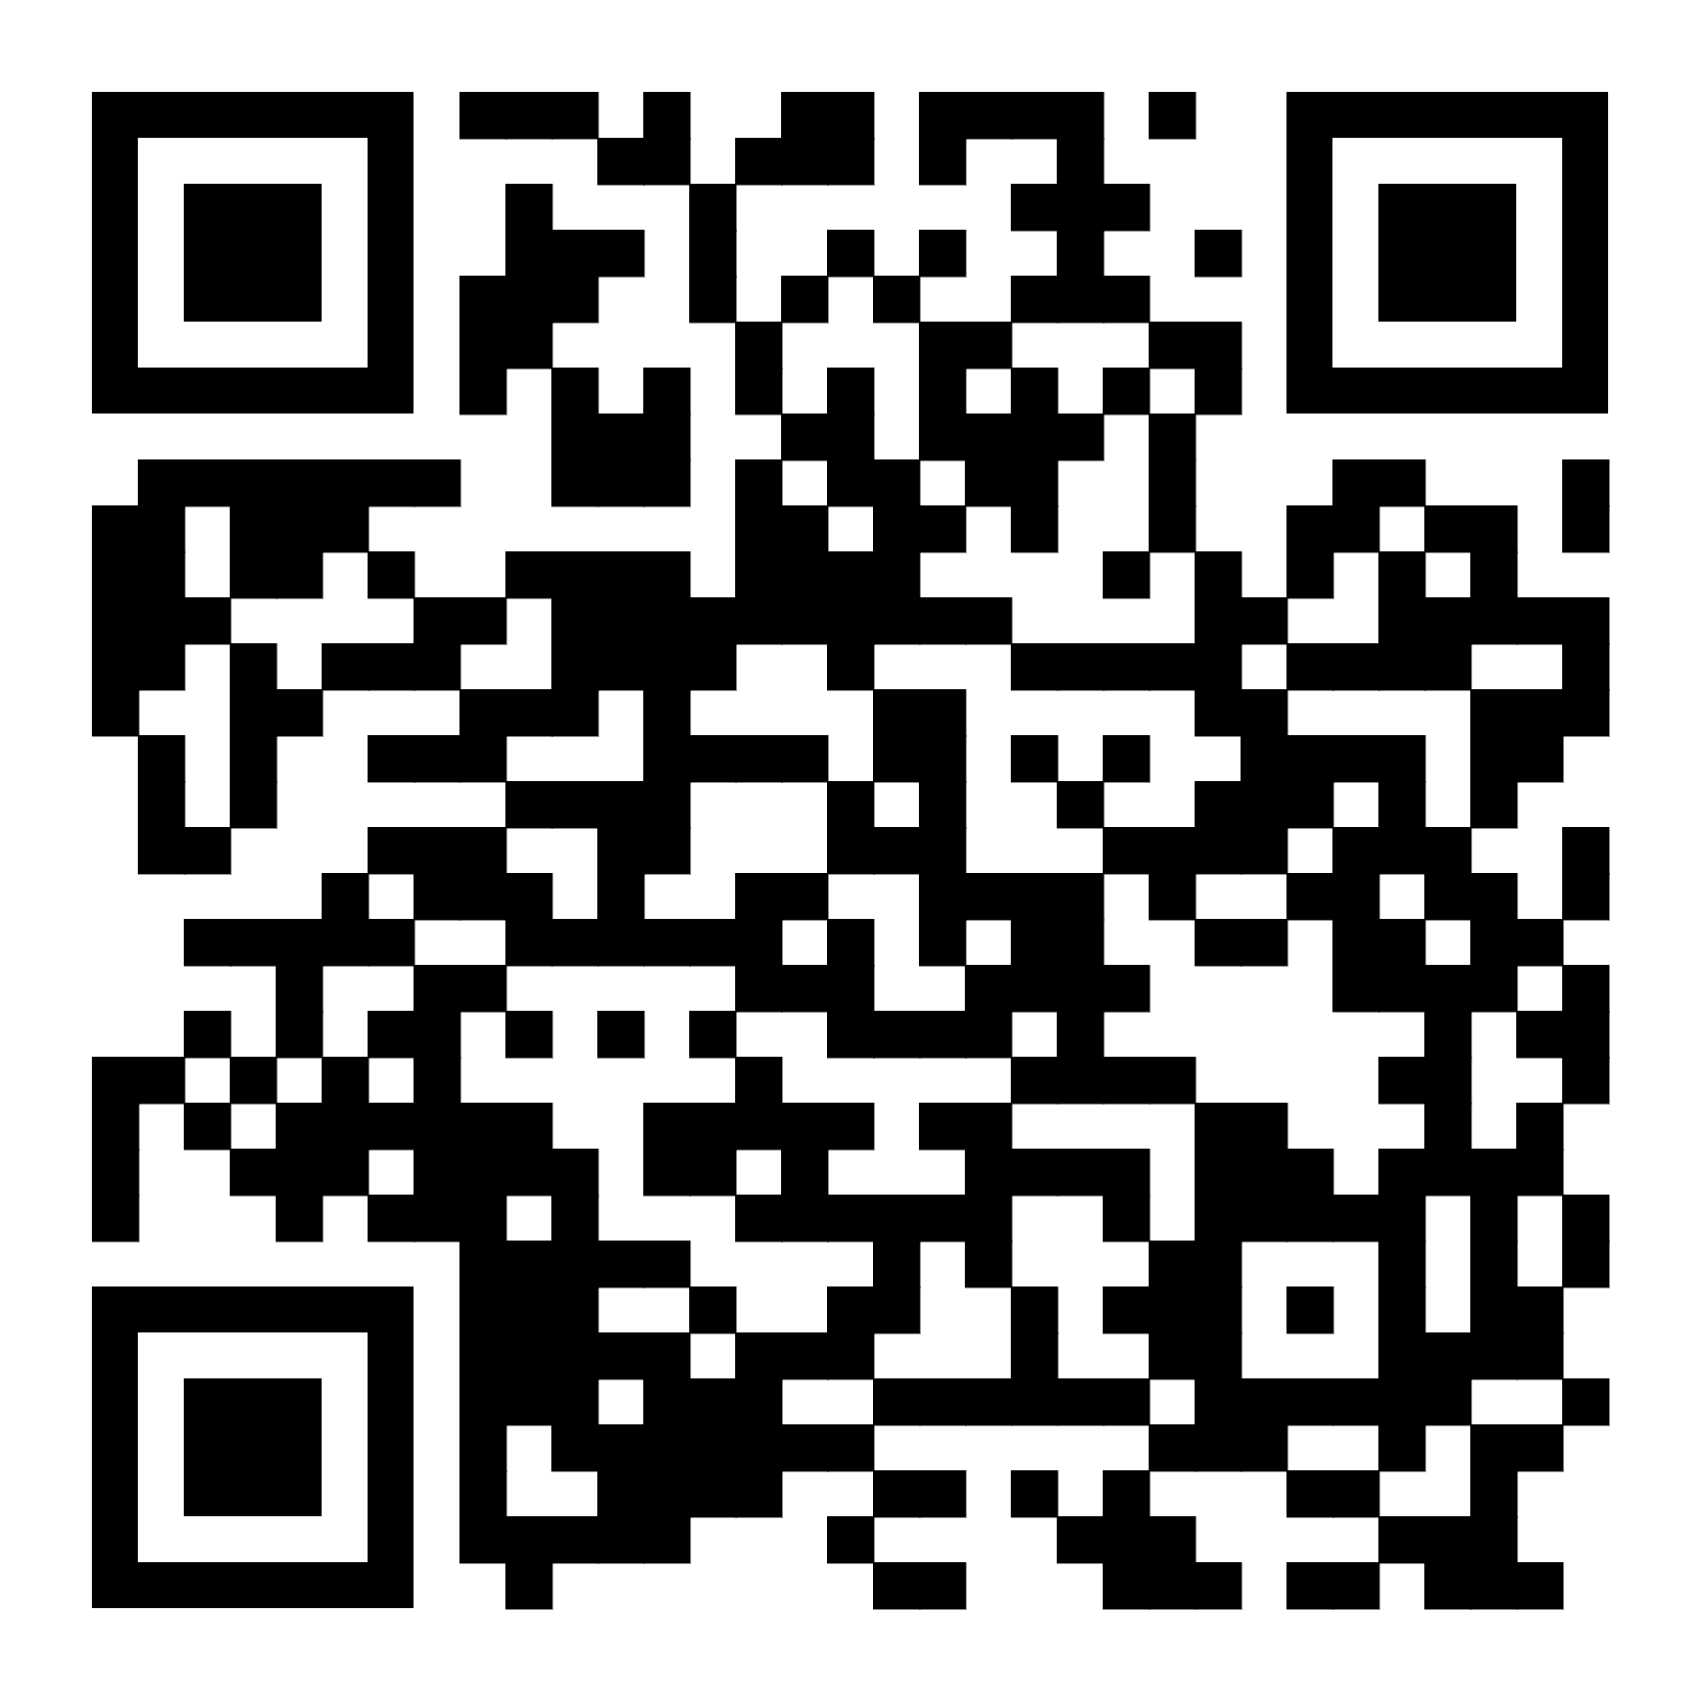
Exploring Interplays of BP with AI and Formal Methods
BP
SMT Solvers
Symbolic Model Checking
Probabilistic Model Checking
Deep Reinforcement Learning
Available in the BPpy package
Notes:
Now that we have some idea about BP, let’s move to the project’s contribution. We discuss the integration of BP with SMT solvers, symbolic model checking, probabilistic model checking, and deep reinforcement learning. All of the integrations discussed here are evaluated and publicly available in the BPpy package. The vision behind this project is to create a comprehensive toolbox that harnesses these tools within a unified development framework. We will now go over each integration briefly and discuss the evaluations presented in the paper.

Slide 9

Exploring Interplays of BP with AI and Formal Methods
BP
SMT Solvers
Symbolic Model Checking
Probabilistic Model Checking
Deep Reinforcement Learning
Available in the BPpy package
Notes:
We will start with the SMT solver integration.

Slide 10
SMT Solvers
low_degrees = [Deg(i) for i in range(50)]
def bt_1_discrete():
While True:
yield {waitFor: Hot}
yield {waitFor: All, block: low_degrees}
Events are represented as an assignment over a set of SMT variables.
B-threads specify request/block/waitFor constraints over the variables.
The execution mechanism invokes an SMT solver to find a satisfying assignment to the variables embedded in these constraints during runtime.
Hot, cold = Bool('hot'), Bool('cold')
temp = Real('temp')
def bt_1_solver():
While True:
yield {waitFor: And(hot, Not(cold))}
yield {waitFor: true, block: temp < 50}
Guy Katz, Assaf Marron, Aviran Sadon, and Gera Weiss, "On-the-Fly Construction of Composite Events in Scenario-Based Modeling using Constraint Solvers," Conference on Model-Driven Engineering and Software Development, 2019.
Notes:
This integration is based on previous work in our group, where solvers are integrated into BP's execution. Specifically, in this integration, events are represented as assignments over a set of SMT variables, instead of discrete events. At each synchronization point, b-threads can specify request/block/waitFor constraints over the variables in the form of logical statements to be satisfied. Once all constraints are collected, the execution mechanism uses the solver to find a satisfying assignment to the variables embedded in these constraints. That means that the solver finds an assignment requested by at least one b-thread which is not blocked by any other b-thread.

Slide 11
SMT Solvers
low_degrees = [Deg(i) for i in range(50)]
def bt_1_discrete():
While True:
yield {waitFor: Hot}
yield {waitFor: All, block: low_degrees}
Allows b-threads to communicate versatile variable assignments, going beyond discrete events.
Along with its advantages in enhancing expressiveness, it can potentially improve computation: execution runtime and memory efficiency.
Compared against the discrete mechanism using several parameterized benchmarks.
Hot, cold = Bool('hot'), Bool('cold')
temp = Real('temp')
def bt_1_solver():
While True:
yield {waitFor: And(hot, Not(cold))}
yield {waitFor: true, block: temp < 50}
Notes:
The SMT solver integration provides a richer communication protocol in event selection, which goes beyond the discrete protocol. Along with its advantages in enhancing expressiveness, it can potentially improve BP’s computational capabilities during execution, specifically, execution runtime and memory efficiency. In the paper, we validated this assumption by comparing the conventional discrete mechanism and the presented SMT-based mechanism.

Slide 12

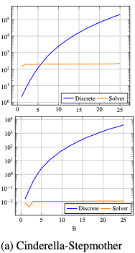
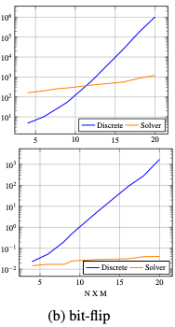
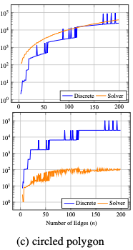
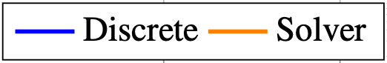


Evaluation
Notes:
The evaluation used several parameterized benchmarks, where we compare the memory and execution time of the discrete mechanism, marked in blue, against the solver mechanism, marked in orange, on equivalent programs. Results were largely as we expected, and the SMT version has significantly improved runtime and memory in most cases.

Slide 13
Exploring Interplays of BP with AI and Formal Methods
BP
SMT Solvers
Symbolic Model Checking
Probabilistic Model Checking
Deep Reinforcement Learning
Available in the BPpy package
Notes:
Continuing with the symbolic model checking integrations

Slide 14
Symbolic Model Checking
Current best practices use explicit model checking (using DFS).
Becomes inefficient as programs increase in size.
Translation to formal model is difficult when the program state is not readily cloneable.
Alternative verification techniques are necessary.
Notes:
So, as with other programming paradigms, verification is a subject of considerable work in BP. However, this work primarily concentrates on explicit model checking, where the entire state space of the system is explored using a DFS, for example. As systems grow in size and complexity, the limitations of explicit model checking become apparent. Also, the translation to a suitable formal model is challenging when the program state is not easily cloneable. To overcome these limitations, the adoption of alternative verification techniques is necessary.

Slide 15
Symbolic Model Checking
How can we develop a symbolic verification approach for behavioral programs?
We propose an approach that:
Translates a b-program to SMV.
Verify it using NuSMV.
The approach utilizes two primary features of behavioral programs: inherent compositionality and unified protocol.
Notes:
So, the question that we are aiming to answer in this research is, how can we develop a symbolic verification approach for behavioral programs? We propose an approach for verifying b-programs by translating them into the SMV symbolic specification language and verifying them using NuSMV. This approach utilizes two primary features of behavioral programs: their inherent compositionality and BP’s unified protocol.

Slide 16
Symbolic Model Checking
Inherent Compositionality:
MODULE add_hot(event)
VAR
state: 0 .. 4;
HOT_requested: boolean;
INIT
state = 0
ASSIGN
HOT_requested :=
case
state = 2 | state = 1 | state = 0 : TRUE;
state = 3: FALSE;
TRUE: FALSE;
esac;
next(state) :=
case
next(event) = HOT : state + 1;
TRUE: state;
esac;
@b_thread
def add_hot():
for i in range(3):
yield {request: Hot}
DFS
Simon Busard and Charles Pecheur. "PyNuSMV: NuSMV as a Python Library." Lecture Notes in Computer Science (2013).
Notes:
The approach takes a simple yet unique action by independently exploring the state space of each b-thread separately and then analyzing the product space symbolically, avoiding the explicit enumeration of all program states. More specifically, each b-thread is translated into an SMV module that reflects the space explored using DFS. In each b-thread module, we have a local variable called state, representing the current state of the b-thread. Additionally, each module contains local Boolean variables for every event that the b-thread may request or block in its statements. For example, since the add_hot b-thread requests the HOT event, its corresponding SMV module contains a Boolean variable called HOT_requested, which dynamically changes based on the current state using the ASSIGN operator.

Slide 17
Symbolic Model Checking
Unified Protocol:
MODULE main
VAR
event:{BPROGRAM_START,BPROGRAM_DONE,HOT,COLD};
bt0: add_hot(event);
bt1: add_cold(event);
bt2: control(event);
INIT
event = BPROGRAM_START
DEFINE
HOT_requested := bt0.HOT_requested;
HOT_blocked := bt2.HOT_blocked;
COLD_requested := bt1.COLD_requested;
COLD_blocked := bt2.COLD_blocked;
HOT_enabled := HOT_requested & !HOT_blocked;
COLD_enabled:= COLD_requested & !COLD_blocked;
TRANS
next(event) != BPROGRAM_START & (!HOT_enabled -> next(event) != HOT) & (!COLD_enabled -> next(event) != COLD) & (HOT_enabled | COLD_enabled -> next(event) != BPROGRAM_DONE) & (event = BPROGRAM_DONE -> next(event) = BPROGRAM_DONE)
@b_thread
def add_hot():
for i in range(3):
yield {request: Hot}
@b_thread
def add_cold():
for i in range(3):
yield {request: Cold}
@b_thread
def control():
While True:
yield {waitFor: Hot}
yield {waitFor: Cold,
block: Hot}
Notes:
To simulate the execution of the program, the SMV main module functions as the event arbiter for the b-program and implements BP semantics. It initiates an enumerated variable called event, representing the currently selected event. The event variable can take any of the events requested across all b-threads, in addition to two helper events, BPROGRAM_START and BPROGRAM_DONE, marking the program’s start and end of execution, respectively. Further, the main module activates all the b-threads of the program as module instances. It tracks each b-thread requested and blocked variables by using the DEFINE operator. To capture the b-program’s dynamics, the system defines a transition relation that allows the next event value to be any currently enabled event, that means, events that are requested and not blocked. If no such event exists, the b-program terminates, and the system transitions to a sink state where the event variable equals BPROGRAM_DONE. This setting allows the detection of possible violations related to the termination of the b-program, such as deadlocks or early termination scenarios.

Slide 18
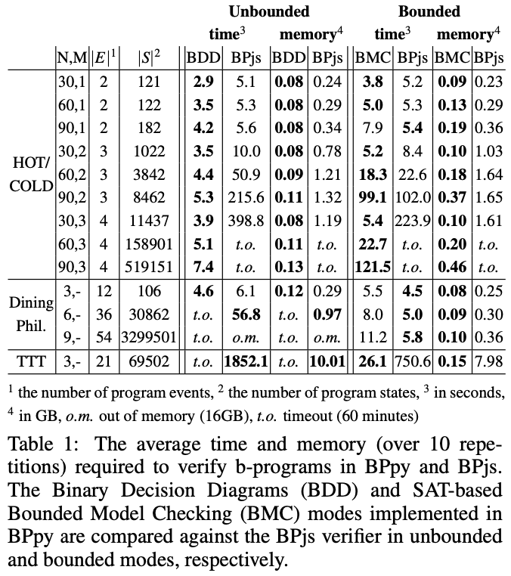
Evaluation
Compared to current best practice in BP verification - BPjs.
The evaluation involved several parameterized b-programs of varying sizes.
The symbolic verifier was assessed in two modes: Binary Decision Diagrams (BDD) and SAT-based Bounded Model Checking (BMC).
Michael Bar-Sinai and Gera Weiss. "Verification of Liveness and Safety Properties of Behavioral Programs Using BPjs." International Symposium on Leveraging Applications of Formal Methods (2021).
Notes:
We conducted a performance evaluation of the approach, where we compared it against the current best practice in BP verification, which is the BPjs model checker. The evaluation involved several b-programs that were parameterized to be checked at different sizes. We assessed the symbolic verifier in two modes: one that uses Binary Decision Diagrams (BDD) and the other is SAT-based Bounded Model Checking (BMC). In terms of memory consumption, as expected, both symbolic model checkers outperformed the BPjs verifier. As for verification time, we observed that the BDD-based model checker excelled in the examples where the total number of events remained relatively small. However, as the number of events increased, the verification time for the BDD-based model checker significantly increased. On the other hand, when considering the bounded option, the BMC method was more resilient to the growing number of events in the b-program, and appears as a more robust approach, as expected.

Slide 19
Probabilistic Model Checking
Modeling and analyzing probabilistic systems using the choice idiom.
Execution - random selection on choice nodes based on a specified distribution.
Analysis - translation into the PRISM (largely similar to the SMV translation).
def coin_flip():
while True:
side = yield choice({Heads: 0.4, Tails: 0.6})
yield {request: side}
Kwiatkowska, Marta, Gethin Norman, and David Parker "PRISM: Probabilistic symbolic model checker," International Conference on Modelling Techniques and Tools for Computer Performance Evaluation, 2002.
Notes:
This work was also extended to model and analyze probabilistic systems in BP using the new choice idiom. Traditionally, randomness in BP is introduced through random functions inside the b-thread or in event selection. The choice idiom allows for a non-uniform distribution that can be analyzed. It defines randomness in a way that enables execution, in the form of regular sampling, and verification using a model translation to PRISM, a tool for probabilistic model checking. The translation process is very similar to the SMV process we've seen in the previous slides. In terms of evaluation, we have also seen promising results similar to those of the symbolic model checking approach.

Slide 20
Exploring Interplays of BP with AI and Formal Methods
BP
SMT Solvers
Symbolic Model Checking
Probabilistic Model Checking
Deep Reinforcement Learning
Available in the BPpy package
Notes:
Continuing with the deep reinforcement learning integration.

Slide 21


Deep Reinforcement Learning (DRL)
Agent
b-thread #1
b-thread #2
b-thread #3
b-thread #4
…
State
Action
Reward
Selected event
Environment
B-program
Train a DRL agent to find a policy that maximizes the reward signal over the program run.
Use the trained agent in the execution mechanism.
Notes:
So, in the basic reinforcement learning setting, an agent interacts with its environment in discrete time steps. At each step, the agent receives the current state and reward. It then chooses an action from the set of available actions, which is enacted in the environment. The environment then moves to a new state which is returned back to the agent along with a reward associated with this transition. The goal of a reinforcement learning agent is to learn a strategy that maximizes the expected cumulative reward. So, in our setting, the environment is the b-program, and the action is the event selected by the execution mechanism. The reward given by the b-program is based on local rewards given by the b-threads in each statement. So, the general approach is very straightforward: first, train a DRL agent to find a policy that maximizes the reward over the program run. Then, use the trained agent in the execution mechanism.

Slide 22
Deep Reinforcement Learning (DRL)
A local reward parameter can be added to b-threads statements, allowing developers to delineate the program’s target objectives or optimization criteria.
B-threads rewards can be combined using a predefined function (e.g., sum).
A DRL agent can be trained, treating the BP model as an environment.
The learned event selection strategy can be deterministic or non-deterministic.
@b_thread
def add_hot_drl():
for i in range(3):
yield {request: Hot, localReward: -0.01}
yield {request:All, localReward:1}
Notes:
To support this integration, we added a local parameter called localReward. This parameter can be added to each b-thread and each statement to specify target objectives or optimization criteria. For example, here on the right, we can see that we give a positive reward only if we finish doing hot 3 times. The local rewards of all the b-threads are combined together using a predefined function. Then, a DRL agent can be trained on the combined reward, treating the BP model as an environment. The mechanism or strategy that is learned can be deterministic or non-deterministic, and it has different uses and purposes, as we will see now.

Slide 23
Deep Reinforcement Learning (DRL)
Deterministic event selection strategy - optimization requirements:
Considering available resources.
Achieving predefined objectives.
In the Hot/Cold example - “finish pouring three hot water portions as soon as possible.”
Execution mechanism - take the action with the optimal outcome at each step.
@b_thread
def add_hot_drl():
for i in range(3):
yield {request: Hot, localReward: -0.01}
yield {request:All, localReward:1}
Notes:
In a deterministic setting, the event selection mechanism can only choose one event at each synchronization point. This is more suitable for situations where we want to optimize something, consider available resources, or achieve a certain goal. For example, in the HOT/COLD example, we can specify to finish pouring hot water three times as soon as possible, and then it suits this setting better. In terms of the execution mechanism, the meaning of this is very simple, and is to take the event with the best outcome at each stage, according to what the agent has learned.

Slide 24
Deep Reinforcement Learning
Non-deterministic event selection strategy::
The DRL agent task is to distinguish between violating and legal runs.
Reduce violations and achieve permissive behavior.
In the Hot/Cold example - “eventually finish pouring three hot water portions.”
Execution mechanism - take actions with expected reward values bigger than some threshold (e.g., 0).
@b_thread
def add_hot_drl():
for i in range(3):
yield {request: Hot, localReward: -0.01}
yield {request:All, localReward:1}
Notes:
In a non-deterministic setting, we want an event selection mechanism that allows all runs that do not violate the requirements. This requires the DRL to distinguish between violating and legal runs and, consequently, be able to select multiple events from each state. In this way, it is possible to eliminate runs that violate some requirements while still defining a permissible behavior. If we return to the HOT/COLD example again, then we can specify the original requirement that will fit here, where we want to eventually do three times hot, but it does not have to happen as soon as possible. Now, the running mechanism is required to use the DRL agent in a slightly different way and take actions with expected reward values bigger than some threshold, which changes based on the use case.

Slide 25
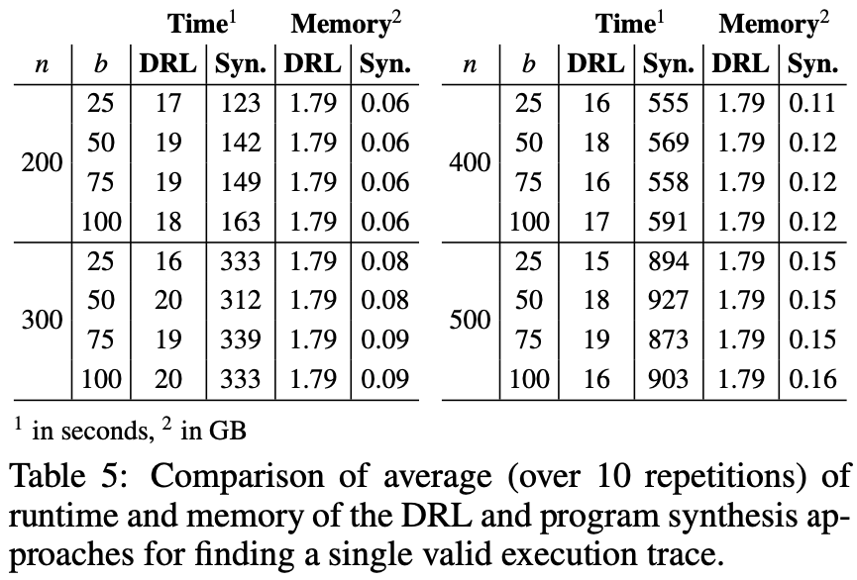
Evaluation
Finding an event selection strategy that reaches some predefined objective in a program.
Compared against current best practice in BP - search-based program synthesis.
Computed the time and memory taken to reach this strategy in several parameterized benchmarks.
Notes:
For evaluation, we focused on the task of finding an event selection strategy that reaches some predefined objective in a program. We compared the DRL approach against the current best practice in BP, which is a search-based program synthesis, and computed the time and memory taken to reach this strategy in several parameterized benchmarks. The results you see in this slide are for the deterministic setting, where we saw that increasing the state space of the program does not dramatically affect the DRL approach time to reach a deterministic strategy. In the paper, we also present some promising results for the non-deterministic setting in the same benchmarks.

Slide 26
Moving Forward
Evaluate use cases that involve multiple integrations.
Assess the usability of our proposed framework to increase adoption and improve accessibility.
Extend to other tools (e.g., large language models).
Notes:
Moving forward, we want to continue to evaluate use cases that involve multiple integrations. We have already presented an initial evaluation in the paper, where we combined DRL, SMT solvers, and probabilistic model checking. So we want to continue and examine such use cases deeper. We also want to assess the usability of the proposed framework to increase adoption and improve accessibility, and extend to other tools. For instance, we already have some early work published on large language model integration.

Slide 27
Thank you for listening
Requirements
Execution engine
Behavior
tomya@post.bgu.ac.il
Agent
b-thread #1
b-thread #2
b-thread #3
b-thread #4
…
State
Selected
event
B-program
Notes:
So, thank you for listening and I’ll be happy to answer questions.

